Slide 1
Paper Review Curiosity-driven Exploration by Self-supervised Prediction
NIKHIL CHALLA

Slide 2
Flashback – What you need to know from literature?
N-step Learning – between TD Learning [ TD(0) ] and Monte Carlo
DQN – Convert images to Feature vectors
Actor Critic RL – Learn both state values and policy.
Gradient Descent – For training NN
LSTM - long-range dependencies
Notes:
LSTM : Long Short Term Memory
DQN = Deep Q Learning
TD : Temporal Difference Learning

Slide 3
What is different?
Converge to best policy based on rewards from the environment for actions performed by agent. (extrinsic rewards)
Extrinsic Rewards might not exist!
E.g. Policy for a 3-year-old kid? (get a job and be independent years into the future)
Maybe we can try curiosity (intrinsic motivation)
Reward Types
[old] Extrinsic reward: provided by the environment
[new] Intrinsic reward: self-generated by agent
Notes:
In order for extrinsic rewards to work, it must not be sparse to ensure that we get some update after each episode
What if episode is too long
What if there is no clear rules for deciding the extrinsic reward.

Slide 4
What is curiosity and how to assign intrinsic rewards?
Curiosity helps an agent explore its environment in the quest for new knowledge.
Curiosity is a way of learning new skills which might come in handy for pursuing rewards in the future.
Intrinsic rewards should encourage the agent to
explore “novel” states. (explore its environment)
predict the consequences of its own actions. (learning new skills)
The exploratory behavior should improve as the agent gains more knowledge!
Notes:
Just like how we have to strike a balance between exploration and exploitation, we need to strike a balance between exploring novel states vs agents ability to predict the consequence of its actions

Slide 5

What features are important?
Different types of features in the image
Controlled by an agent (Mario).
Uncontrollable but affect the agent (angry bots, pipes)
No effect, neither is controllable (clouds, mountains)
Design that makes sense
Reward when agent encounters features that are “learnable” (explore its environment)
Attempt to predict only important feature changes in the environment (learning new skills)
Notes:
https://www.ias.informatik.tu-darmstadt.de/uploads/Team/MichaelLutter/Ritter_DeepLagrangianNetworks.pdf
Note that the agent might receive some extrinsic reward, the agent must be able to factor in both intrinsic and extrinsic rewards. The exception to regular RL agents is that if there is no extrinsic reward, there must be an intrinsic reward.
Takes input of φ(s_{t}) + φ(s_{t+1}), predicts action (a_{t}) taken by agent to move from state (s_{t}) to (s_{t+1})
FORMULATION
Scales to high-dimensional continuous space.
Bypasses directly predicting pixels.
Ignores aspects that have no relation to the agent

Slide 6
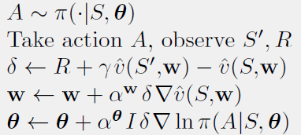
What policy learning method is used?
A3C (Asynchronous Advantage Actor-Critic ) gradient
Actor-Critic:
Actor: Learn Policy
Critic: Learn Value and influence policy
Asynchronous: Multiple agents learn independently but share knowledge with a global network.
Advantage: difference(actual reward - expected reward) impacts the gradient.
Notes:
Algorithm predicts both value function v(s,w) as well as optimal policy function π(a|s,θ). The learning agent uses the value of the Value function (Critic) to update the optimal policy function (actor). The learning agent determines the conditional probability p(a|s;θ)
We typically use a convolutional neural network that has one softmax output for the policy π(a_{t}|s_{t};θ) and one linear output for the value function V(s_{t};θ_{v}), with all non-output layers shared.
ADAM optimizer with its parameters not shared across the workers. Adaptive learning rate where the algorithm Keep track of both the direction of the gradient descent as well as intensity to estimate a decent learning rate for the current terrain.
A3C uses n-step learning where the policy and value function are updated every t_max actions or when the terminal state is reached.
First Snapshot from ?

Slide 7
Summary of Model Types
Forward dynamics model
new image = function ( action , current image )
Inverse dynamics model
action = function ( new image , current image )
[ action is the joystick controller commands ]
Notes:
The paper uses the inverse dynamics model, where the network needs to predict the actions (joystick) taken by the agent to move from one state (image) to another.
Note that the agent might receive some extrinsic reward, the agent must be able to factor in both intrinsic and extrinsic rewards. The exception to regular RL agents is that if there is no extrinsic reward, there must be an intrinsic reward.
Takes input of φ(s_{t}) + φ(s_{t+1}), predicts action (a_{t}) taken by agent to move from state (s_{t}) to (s_{t+1})

Slide 8
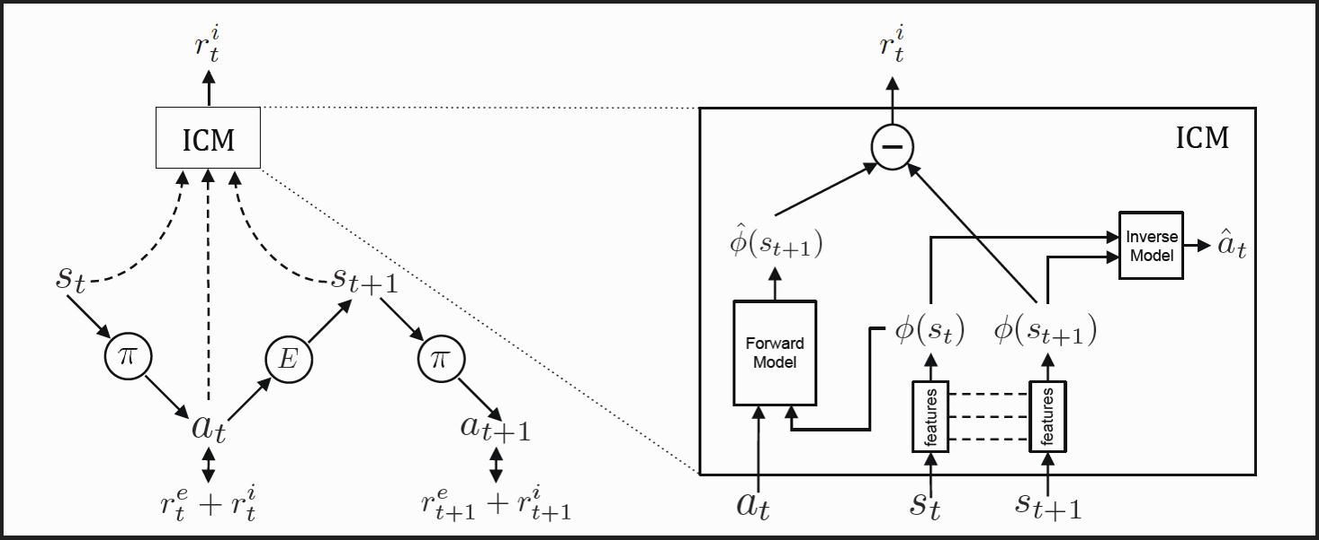
Complete Block Diagram (one thread from A3C)
Notes:
Learn not predict

Slide 9
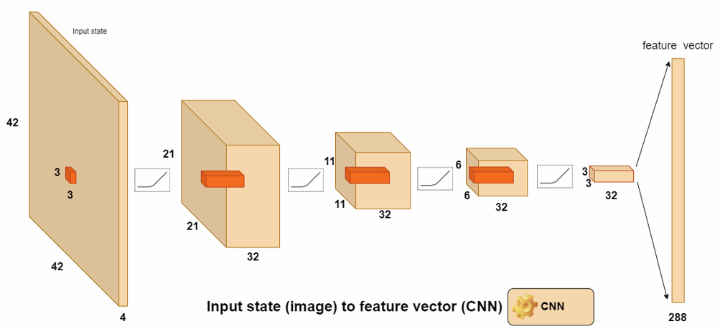
Convolutional Neural network
Notes:
Rather than hand designing the features, they used CNN to build the features!
The trick is if the image is an odd number, then divide by 2 and take the ceiling. If the number is even, just divided by 2. this will be the new output image size
We use ELU (exponential linear unit as activation function)
f(x) = x if x > 0
α (exp(x) - 1) if x < 0
Properties (over ReLU)
Differentiable in the entire region
Ability to set the lowest limit
https://towardsdatascience.com/how-to-easily-draw-neural-network-architecture-diagrams-a6b6138ed875
https://www.tensorflow.org/api_docs/python/tf/nn#notes_on_padding_2 = understand padding based on filter and stride
https://www.researchgate.net/publication/331794632_On_the_Creation_of_a_Chess-AI-Inspired_Problem-Specific_Optimizer_for_the_Pseudo_Two-Dimensional_Battery_Model_Using_Neural_Networks/figures?lo=1 Figure for ELU

Slide 10
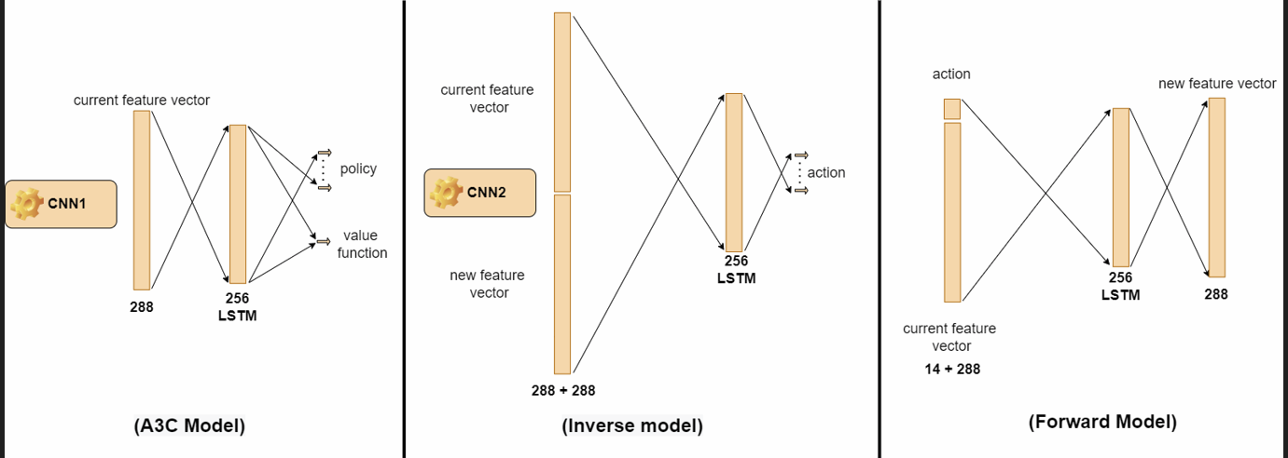
A3C Model, Forward Model and Inverse Model
Notes:
Similar to DQN except we have LSTM before nodes for action
LSTM : does not guarantee that there is no vanishing gradient or exploding gradient, but it does provide a better way for the model to learn when one has long-distance dependencies.
We need LSTM due to long-range dependencies, or the agent needed to perform the same action multiple times to achieve certain moves [like long jumps]
one softmax output for the policy + one linear output for the value function

Slide 11
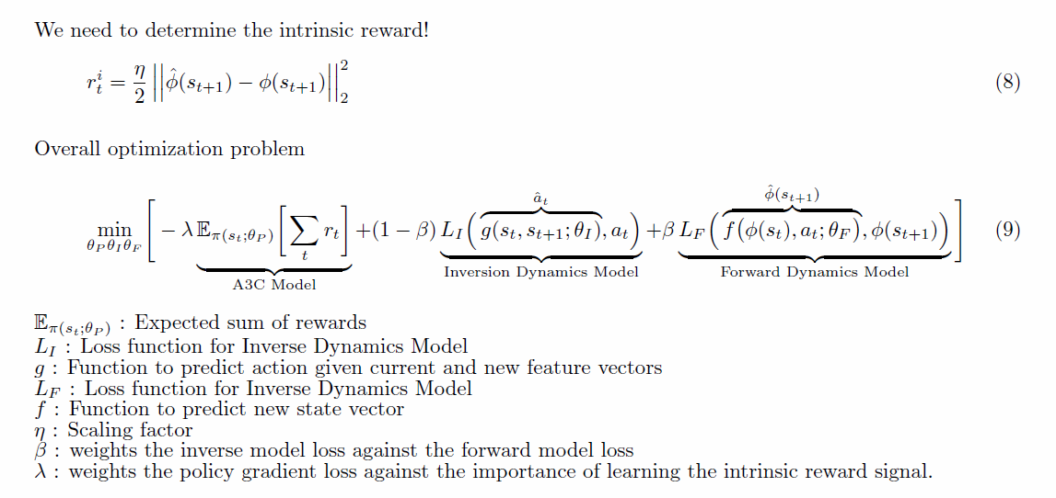
Intrinsic Reward and optimization problem

Slide 12
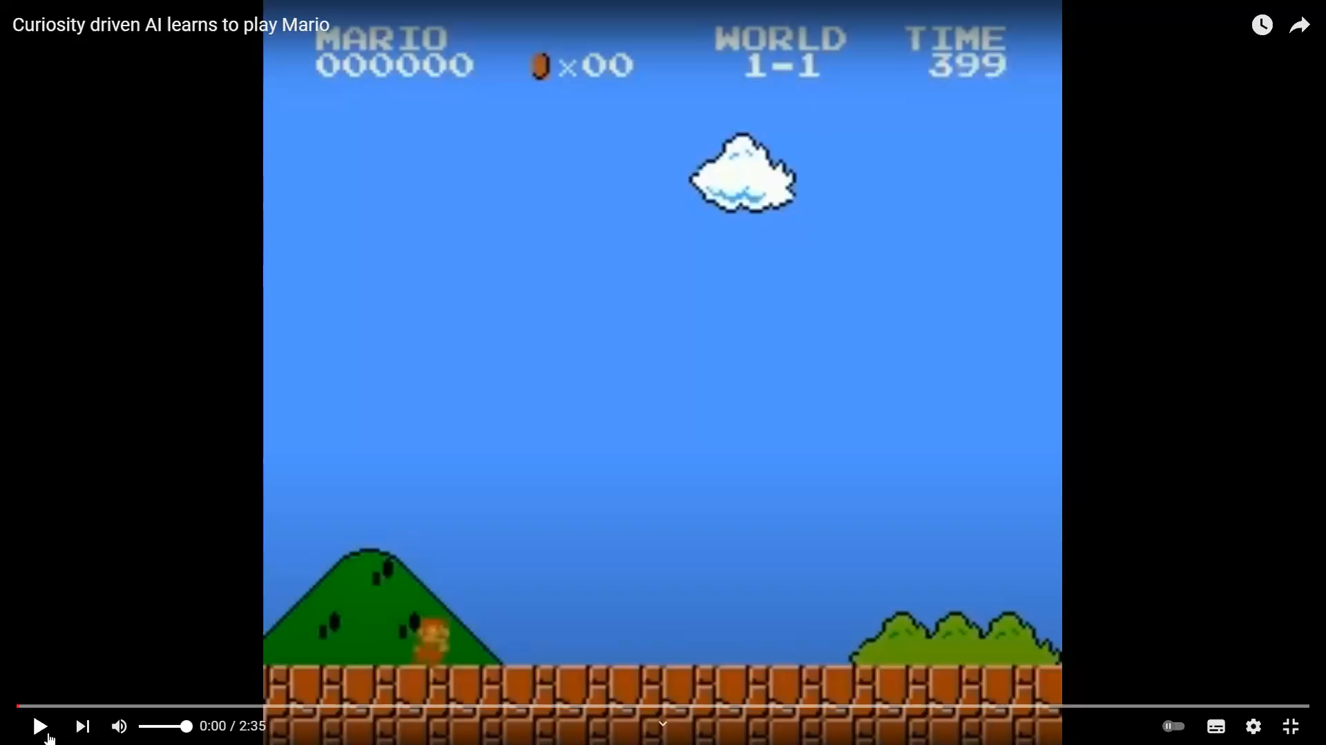
Spot the odd actions!
Notes:
Noticed the skills it has learned…
1. It doesn’t care about coins/mushrooms or gaining more points (that increment on top)
2. Walking next to angry bots is not good, so you need to jump over them or on them.
3. Walking next to a pipe is ok/harmless but you cannot walk across them, you need to jump.
4. Walking next to background scenes (clouds/mountains) is harmless
Fewer interactions would mean focusing on survival and exploration.

Slide 13
The End but Mario’s journey to be continued…

